Slide 1
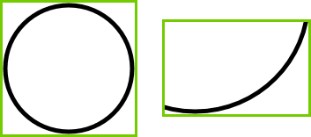
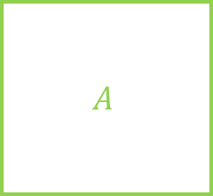

$$A$$
$$\vec{p}$$
m_vTopLeft
m_vBottomRt

Slide 2




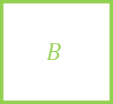
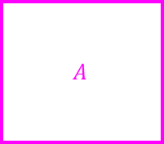



$$\vec{u}=[u_{x},u_{y}]$$
$$\vec{p}=[p_{x},p_{y}]$$
$$\vec{v}=[v_{x},v_{y}]$$
$$[a_{l},a_{t}]$$
$$A$$
$$[b_{l},b_{t}]$$
$$B$$
$$[a_{r},a_{b}]$$
$$[b_{r},b_{b}]$$

Slide 3
CShape
CLine
CLineSeg
CKinematicLineSeg

Slide 4
CShape
CPoint
CKinematicPoint

Slide 5
CShape
CCircle
CArc
CKinematicCircle
CKinematicArc
CDynamicCircle

Slide 6
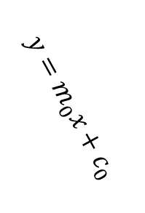
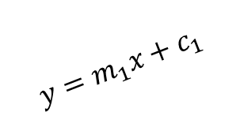



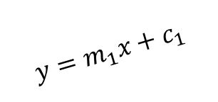
$$x=c_{0}$$
$$y=m_{0}x+c_{0}$$
$$\vec{p}=[p_{x},p_{y}]$$
$$y=m_{1}x+c_{1}$$
$$y=m_{1}x+c_{1}$$
$$\vec{p}=[p_{x},p_{y}]$$

Slide 7









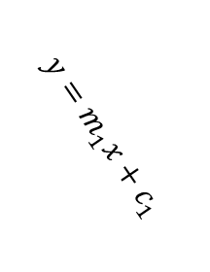

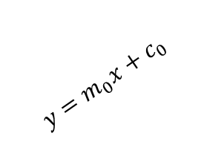

$$Y$$
$$B$$
$$y=m_{0}x+c_{0}$$
$$y=m_{1}x+c_{1}$$
$$d_{y}$$
$$90°−θ$$
$$90°+θ$$
$$θ$$
$$A$$
$$X$$
$$d_{x}$$
$$D$$
$$C$$

Slide 8



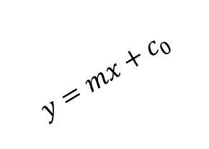






$$y=\frac{−1}{m}x+c_{1}$$
$$L_{0}$$
$$\hat{n}$$
$${\hat{t}}_{1}$$
$${\hat{t}}_{0}$$
$${\vec{p}}_{1}$$
$${\vec{p}}_{0}$$
$$y=mx+c_{0}$$
$$\vec{p}$$
$$L_{1}$$

Slide 9
















$$r$$
$${\vec{p}}_{1}$$
$$d$$
$$\vec{v}$$
$$\hat{n}$$
$$\vec{p}$$
$$d$$
POI
$${\vec{p}}_{0}$$
$$d$$
$${\vec{p}}_{0}$$
$$\vec{p}$$
$${\vec{p}}_{1}$$
$$r$$
$${\vec{p}}_{1}$$
$$\vec{v}$$
$$\vec{v}$$
$$r$$
$${\vec{p}}_{0}$$
$$\vec{p}=\vec{0}$$

Slide 10











$${\vec{p}}_{2}$$
$${\vec{p}}_{2}$$
$${\vec{p}}_{1}$$
$${\hat{t}}_{1}$$
$${\hat{t}}_{0}$$
$${\vec{p}}_{0}$$
$${\vec{p}}_{2}$$
$${\vec{p}}_{1}$$
$${\hat{t}}_{1}$$
$${\vec{p}}_{0}$$
POI
$${\hat{t}}_{0}$$

Slide 11








$$\vec{v}$$
$${\vec{p}}_{0}$$
$$\vec{p}$$
POI
$${\vec{p}}_{0}$$
$$\hat{n}$$
$${\vec{p}}_{0}+r\hat{n}$$
$$r$$
$$\vec{p}$$

Slide 12

























$${\vec{p}}_{0}$$
$${\vec{p}}_{0}$$
$$r$$
$$δ$$
$$\vec{u}$$
$$\vec{u}$$
$$\vec{v}$$
$${\hat{v}}_{0}$$
$$d$$
$$θ$$
$$X$$
$${\hat{v}}_{1}$$
$$\vec{p}$$
$$φ$$
$$\vec{p}$$
$${\vec{p}}_{1}$$
$${\vec{p}}_{1}$$
$${\vec{p}}_{0}$$
$$\vec{u}$$
$$r$$
$$θ$$
$$X$$
$$\vec{p}$$
$${\vec{p}}_{1}$$
$$φ$$

Slide 13

















$$r_{0}$$
$$r_{0}$$
$$r_{1}$$
$$r_{0}−r_{1}$$
$$r_{1}$$
$$r_{1}$$
$${\vec{q}}_{0}$$
$${\vec{p}}_{0}$$
$${\hat{n}}_{0}$$
$${\hat{n}}_{1}$$
$$\vec{u}$$
$${\vec{q}}_{2}$$
$$r_{1}$$
$${\vec{p}}_{1}$$
$$\vec{p}$$
$${\vec{q}}_{1}$$
$${\vec{q}}_{3}$$

Slide 14






















$${\vec{p}}_{1}$$
$${\vec{p}}_{1}$$
$$α_{1}$$
$${\hat{t}}_{1}$$
$${\vec{p}}_{0}$$
$${\vec{p}}_{0}$$
$$α_{0}$$
$${\hat{t}}_{0}$$
$${\hat{t}}_{0}$$
$${\vec{p}}_{0}$$
$${\hat{t}}_{1}$$
$${\vec{p}}_{1}$$
$$α_{0}$$
$${\vec{p}}_{1}$$
$$α_{1}$$
$${\vec{p}}_{0}$$
$$α_{1}$$
$${\hat{t}}_{1}$$
$$α_{0}$$
$$α_{0}<α_{1}$$
$${\hat{t}}_{0}$$
$$α_{0}>α_{1}$$

Slide 15
















$${\vec{q}}_{1}$$
$${\vec{p}}_{1}$$
$${\vec{q}}_{1}$$
$${\vec{p}}_{0}$$
$${\vec{p}}_{1}$$
$${\vec{p}}_{0}$$
$${\vec{p}}_{1}$$
$${\vec{p}}_{0}$$
$${\vec{q}}_{2}$$
$${\vec{q}}_{0}$$
$${\vec{q}}_{2}$$
$${\vec{q}}_{0}$$
$${\vec{p}}_{0}$$
$${\vec{p}}_{1}$$
$${\vec{q}}_{3}$$
$${\vec{q}}_{3}$$

Slide 18















$$\vec{p}$$
$$α$$
$$α_{1}$$
$$α_{0}$$
$$α_{0}<α<α_{1}$$
$$α$$
$$α_{0}$$
$$α_{0}$$
$$\vec{p}$$
$$α_{1}$$
$$α_{1}$$
$$α$$
$$\vec{p}$$
$$α<α_{1}$$
$$α>α_{0}$$

Slide 19



Circle described by POI as kinematic shape rotates
$$\vec{u}$$
POI
$$\vec{w}$$
$${\vec{w}}_{⊥}$$
Center of rotation

Slide 20
No contact
Bad Contact
Good Contact
POI

